Slide 1

Incident Management Contacts
For Supplier Parties to provide and maintain up to date email contact details for use in Incident Management Scenarios as outlined in Clause 30.13.

Slide 2

Key Responsibilities of Suppliers
Provision of Contact Emails
  Suppliers must provide one or more contact emails to the Secretariat for incident notification from Distributors. To do this, please use the self-service party management portal (https://www.dcusa.co.uk/party-management/) and following the instructions in the upcoming slides.
Annual Confirmation Requirement
  Contact email addresses must be confirmed and updated annually by 30 September to ensure accuracy. End of September was chosen because it is the lead up to winter and that is the most likely time for major incidents to occur.
Importance of Updates
  Whilst there is a requirement for Suppliers to do this annually by the end of each September, you can always do this at any time throughout the year. Keeping these details up to date means distributors will have the correct details to let you know about any major incidents on their networks, otherwise, you might be kept in the dark and may not know what to say to your customers if the phone you for information.
Notes:
Suppliers are required to provide one or more contact email addresses to the Secretariat for receiving incident notifications from the Distributor. These email addresses must be kept up to date and confirmed annually by 30 September. This ensures that the Distributor can effectively communicate important updates regarding electricity supply interruptions. The Secretariat will publish these contact details on the DCUSA website and update them as soon as reasonably practicable when changes are notified. This process is crucial for maintaining a reliable communication channel between Distributors and Suppliers, enabling timely responses to incidents that may affect customer service and operational planning.

Slide 3
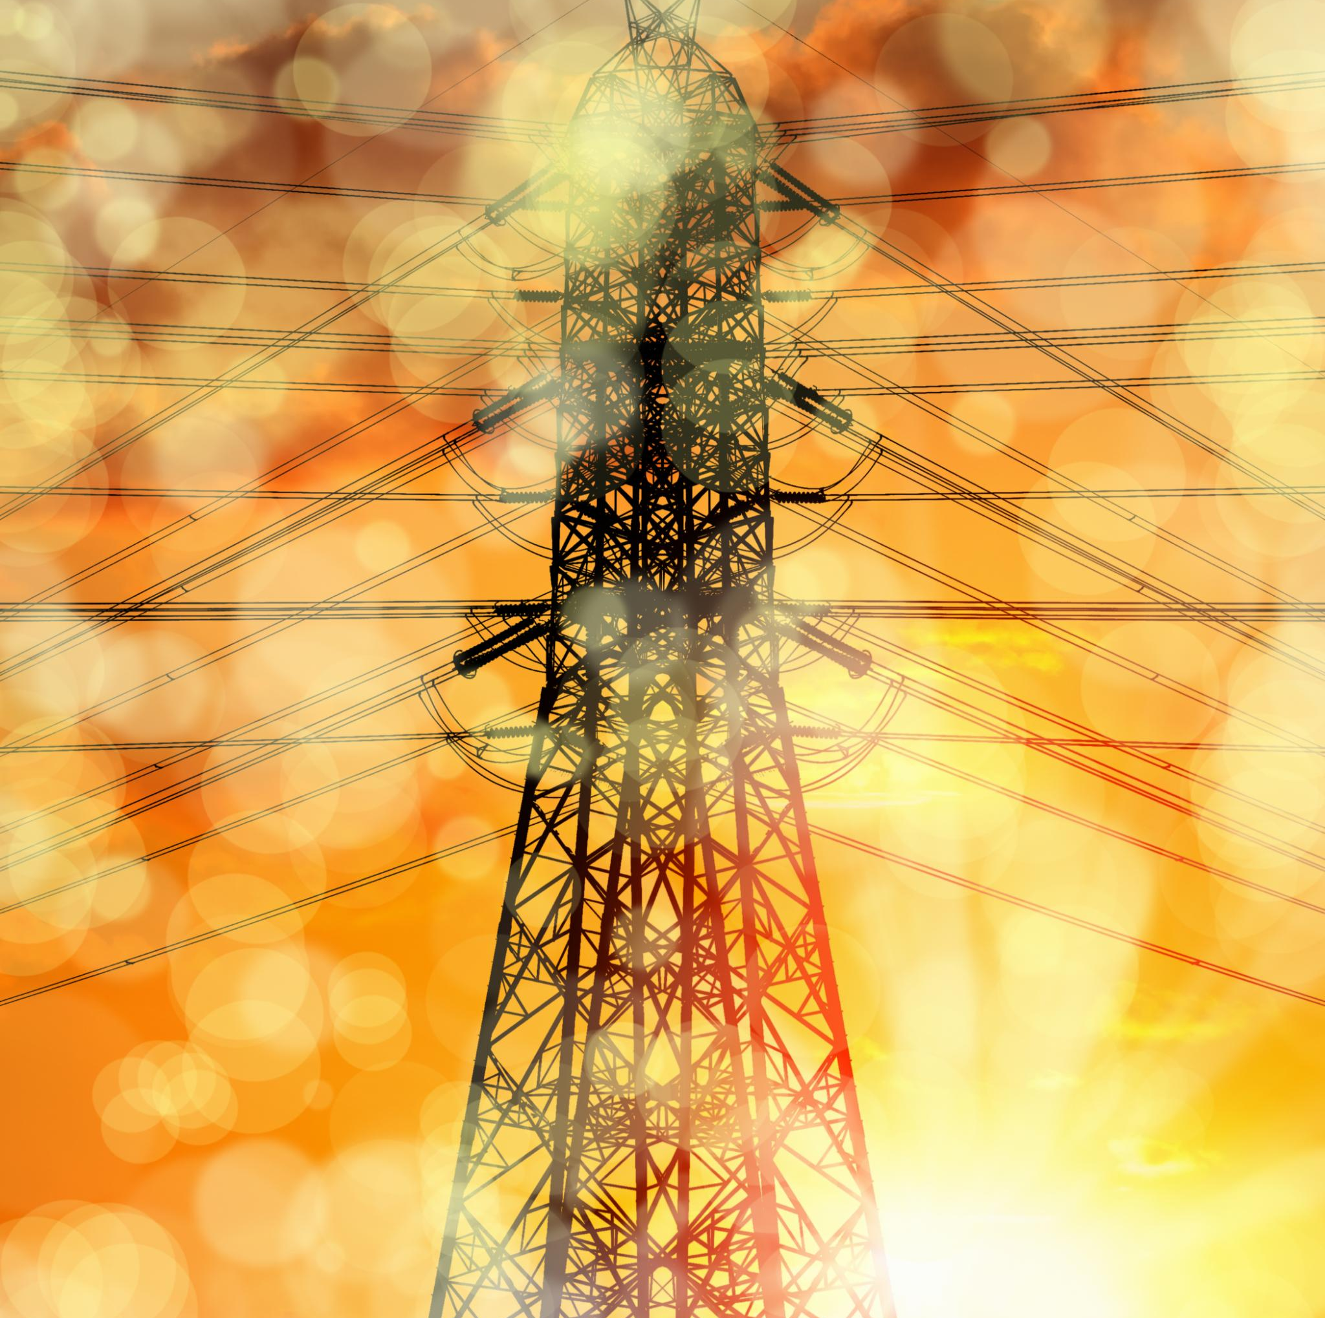
Distributor Obligations During Incidents
Incident Notification Requirements
  Distributors must notify suppliers by email when supply interruptions affect over 5,000 customers and voltage exceeds 1,000 volts.
Details Included in Notification
  Notification must include affected customer numbers, impacted areas, incident nature, and estimated restoration time.
Restoration Confirmation
  After power restoration, distributors send follow-up emails confirming supply has been reinstated.
Purpose of Notifications
  Notifications keep suppliers informed, helping manage customer expectations and coordinate response actions.
Notes:
When a Distributor becomes aware of a significant incident affecting electric lines with a nominal voltage exceeding 1,000 volts and interrupting electricity supply to more than 5,000 customers, they are obligated to notify Suppliers via email. The notification should include the approximate number of affected customers, the postcodes or areas impacted, the nature of the incident if known, and the anticipated time for restoration of supply. Additionally, once the electricity supply is restored, the Distributor should send a follow-up email confirming the restoration. These obligations ensure that Suppliers are kept informed about major disruptions, allowing them to manage customer expectations and coordinate necessary actions.

Slide 4

Exceptions and Importance of Notifications
Notification Exceptions
  When incidents are severe, full details may not be immediately provided by distributors, but reasonable notification efforts are required.
Supplier Notification Criteria
  Notifications related to incidents affecting a large number of customer and information related to restoration timeframes are sent only to Supplier Parties with a valid 'Incident Management' email address contained on the Escalation Contacts page (https://www.dcusa.co.uk/about-dcusa/escalation-contacts/ .
Importance of Timely Notifications
  Timely notifications help Suppliers respond effectively, improving service, operational planning and ability to explain information to their customers.
Click me to see how to manage the contact details
Notes:
In cases where the severity of an incident or a combination of incidents makes it impractical for the Distributor to provide full details immediately, they are still expected to use reasonable efforts to notify Suppliers about the occurrence and location of the incident. They should also inform Suppliers when the electricity supply has been restored. These notifications are only required if the Supplier is a Supplier Party and has provided an appropriate email address for receiving such updates. The importance of these notifications lies in enabling Suppliers to stay informed and respond effectively to service disruptions. Timely and accurate communication supports better customer service, operational planning, and overall reliability in electricity distribution.

Slide 5
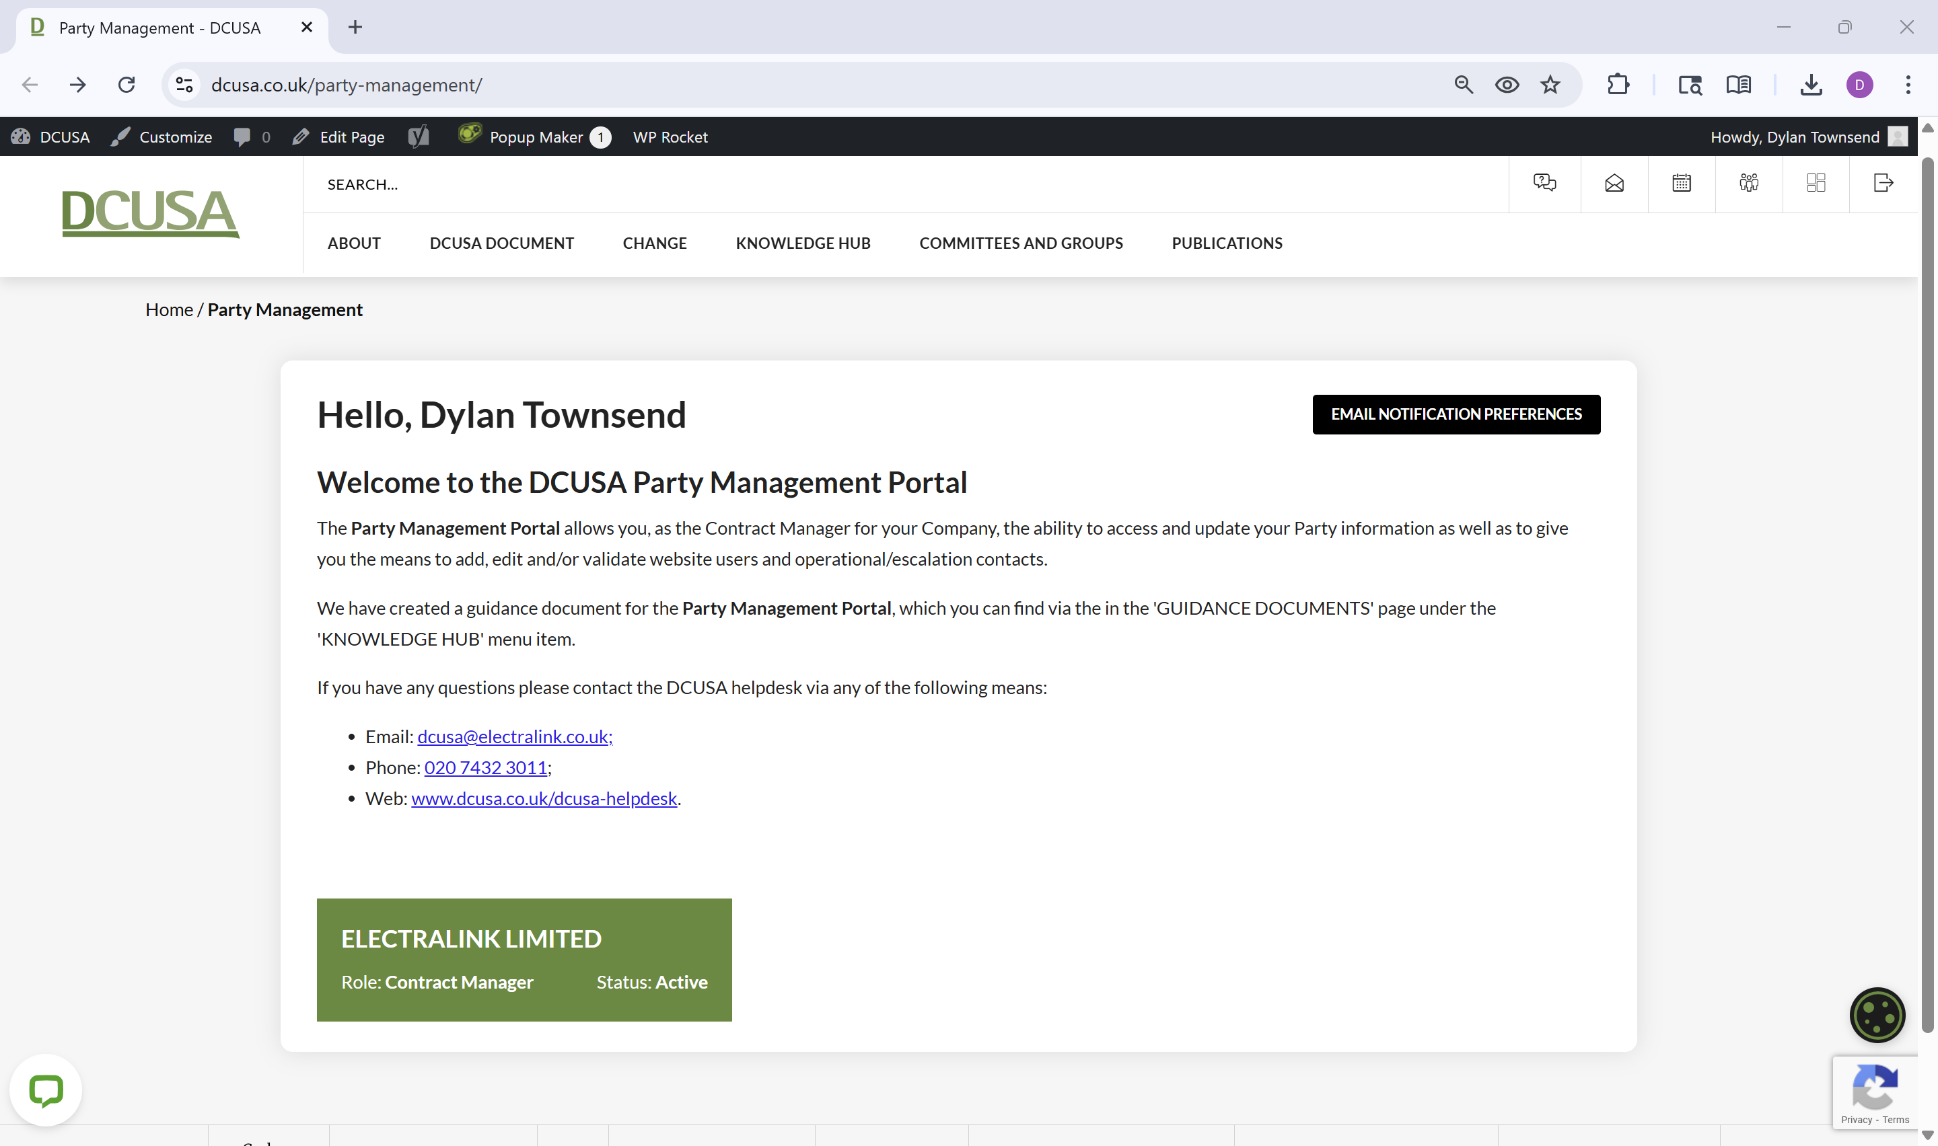
Click Me!
ELECTRALINK LIMITED
Role: Contract Manager Status: Active

Slide 6
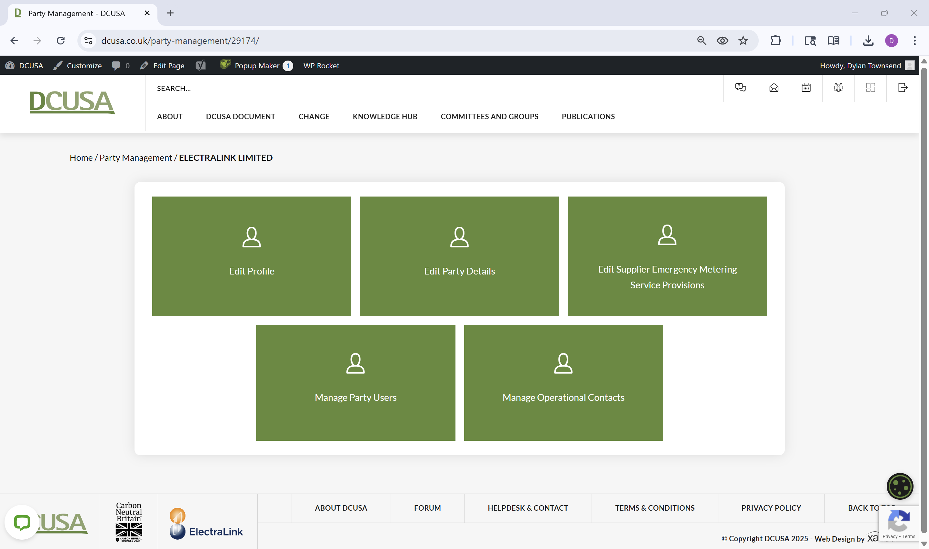
Click Me!
Manage Operational Contacts
Click Me!

Slide 7
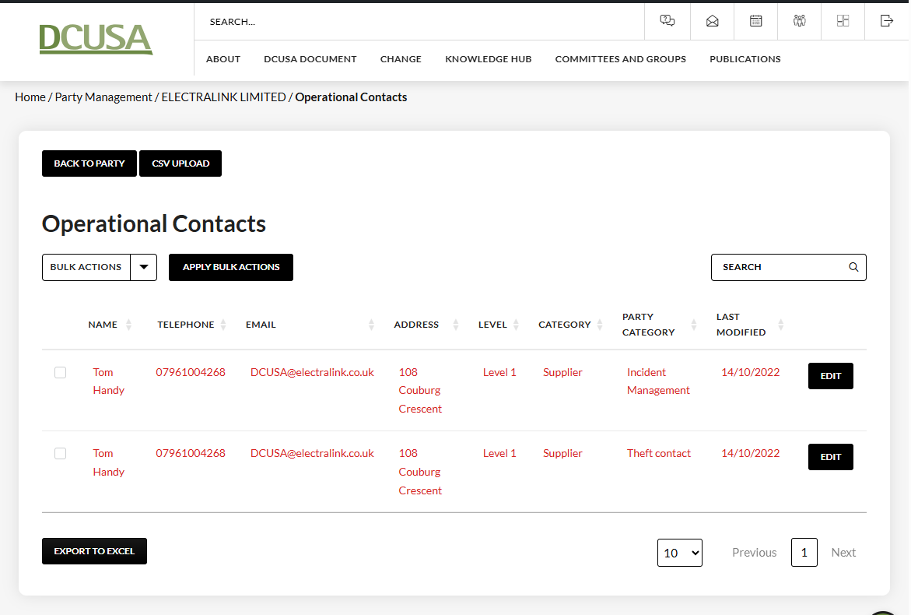
Once on this page, you have a few options, you’ll either need to just validate the contact details set out or you may need to edit the details or if none are present, create new details.

Slide 8
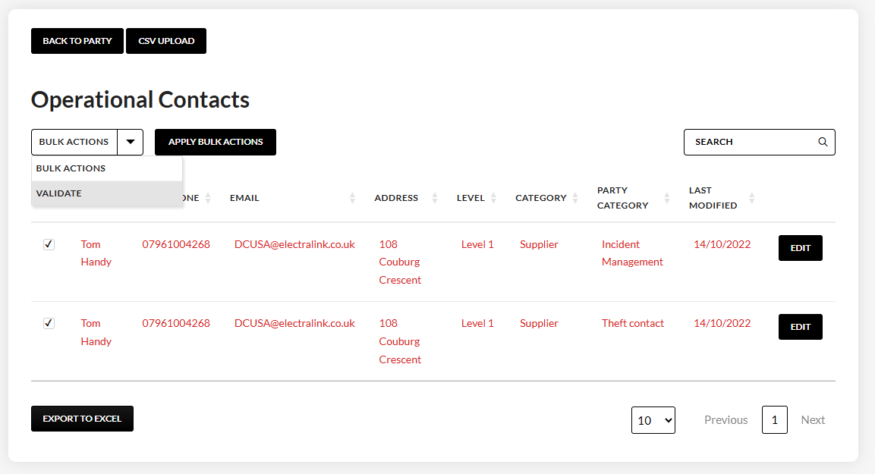
STEP 2
You can validate your contacts in bulk by clicking this drop down and then selecting the ‘VALIDATE’ option and finally click the ‘APPLY BULK ACTIONS’ button to the right and go to next page of this document
STEP 3
If you need to edit the contact details for a particular contact, then select the EDIT button
EDIT
Click me to see how to edit a contact
STEP 1
Review contact details and confirm if still current and if so, tick these boxes as you need to validate those contacts which is what the red text indicates

Slide 9
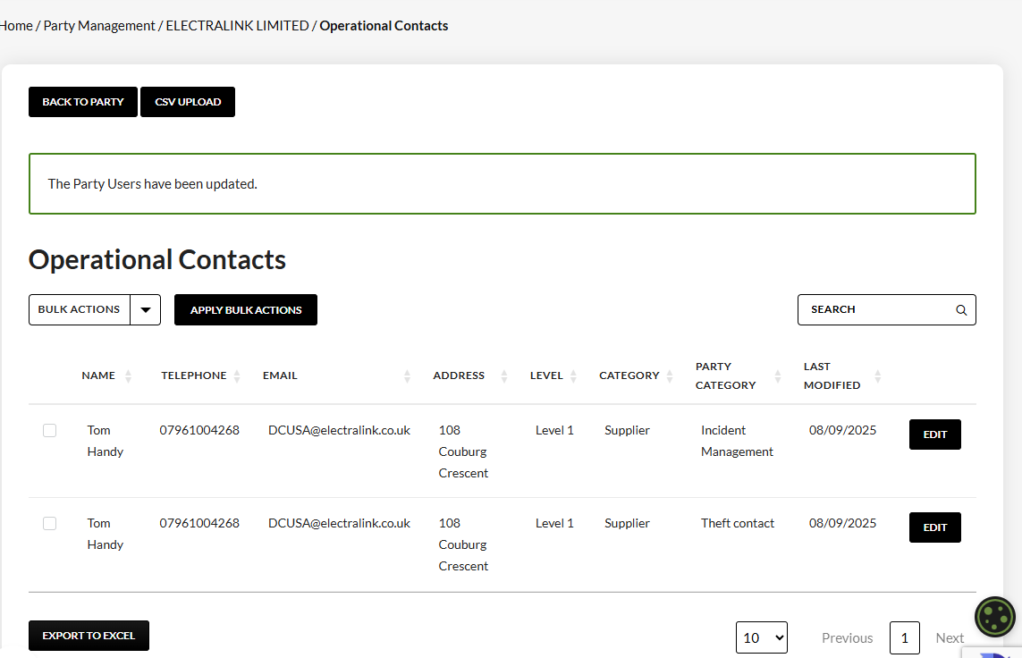
After validation, you’ll see a message appear as per this box with a green border.
You should also notice that the contact details are now in black text, and not red, meaning your contacts have been validated.

Slide 10
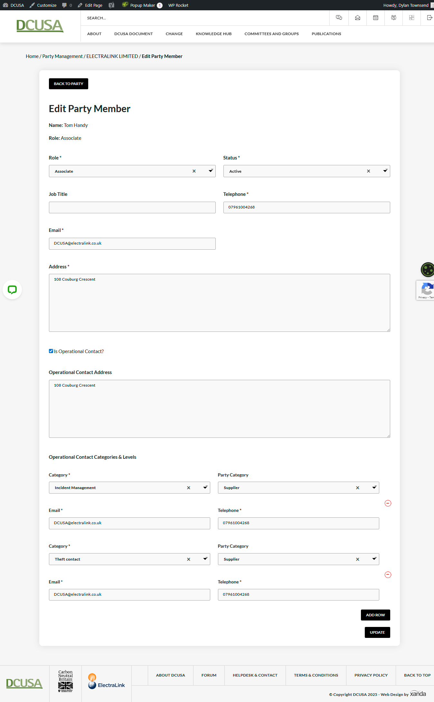
Click the arrow to scroll up!
Here you can fill in the details for the “Incident Management" contact (email address is most important) which will be used by distributors in scenarios where there is a power outage affecting a large number of customers
(please only select “Incident Management" from the ‘Category’ drop down as ‘Theft’ contacts are no longer under the DCUSA)
This part of the page is for editing the website user details and will not populate any operational contact details. Please use the tick box at the bottom left to show the other contact details or if already ticked then just scroll down to view.
If this box is ticked, then you will be able to scroll down and review the operational contact details recorded for this user. If not ticked, but you would like to assign this user as an operational contact then select the box and you’ll be able to complete the form below
Click the arrow to scroll down!

